Slide 1
USE OF PYTHON IN MEDICAL IMAGING(PACS)
FEMI OLADELE

Slide 2
What is Medical Imaging?
The technique and process of creating visual representations of the interior of a body for clinical analysis and medical intervention
Medical Imaging is used for both diagnosis and therapeutic purposes as such it is a powerful tool available to effectively care for patients
Common imaging types for diagnosis include: CT(Computer Tornography), MRI(Magnetic Resonance Imaging), Ultrasound, X-ray.

Slide 3
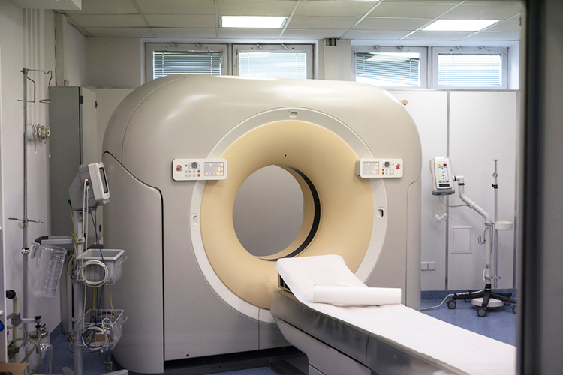
Magnetic Resonance Imaging Machine

Slide 4
Evolution of Medical Imaging
Began in November 1895 with Wilhelm Conrad Roentgen’s discovery of X-ray
Computers really made an entrance into the world of Medical Imaging in early 1970s with the advent of CT and the MRI
1995 DICOM (Digital Imaging and Communications in Medicine) Standard was formalized) to solve the problem of compatibility of images generated by various machine types.
First Generation PACS in early ‘90s was designed to deliver relatively large files over radiology departments network

Slide 5
Digital Imaging and Communications in Medicine(DICOM)
This is a standard for handling, storing, printing and transmitting information in medical imaging.
It includes a file format definition and a network communications protocol.
Files are saved in .dcm extensions

Slide 6
Picture Archiving and Communications Systems(PACS)
PACS is a medical imaging technology that can do the following:
Provide economical storage of and convenient access to, patient study images from multiple imaging modalities
Transmit digital images and electronic reports via network
Enhances Radiology productivity and workflow
Improves patient care

Slide 7
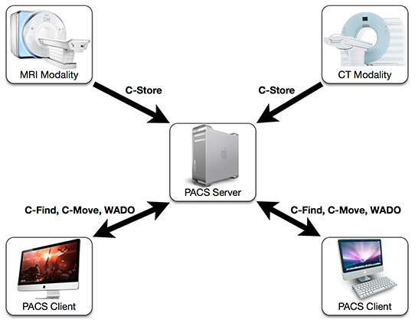
PACS

Slide 8
PYDICOM
A pure Python package for working with DICOM files such as medical images, reports and radiotherapy objects.
Makes it easy to read complex files into pythonic structures for easy manipulations
Modified datasets can be written again to DICOM file formats
Is not a DICOM server and is not primarily about viewing images, it shines most in the areas of manipulating data elements in DICOM files using python codes

Slide 9
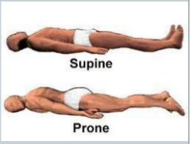
Simple usage of PYDICOM
To read a radiotherapy plan file, change the patient setup from head-first-supine to head-first-prone and save to a new file.

Slide 10
Supine to Prone with PYDICOM Code Example 1
https://gitlab.com/profemzy/pyconng-medical-imaging.git (supine-prone.ipynb)

Slide 11
Viewing Images
As mentioned earlier Pydicom is more focused on accessing the DICOM data elements in files but it is also desirable to view pixel data as an image
The following options are available:
Use any of the many DICOM viewer programs available
Use pydicom with matplotlib
Use pydicom with Python’s stdlib Tkinter module
use pydicom with the Python Imaging Library (PIL)
use pydicom with wxPython

Slide 12
Using PYDICOM with matplotlib Code Example 2
https://gitlab.com/profemzy/pyconng-medical-imaging.git (pymatplot.ipynb)

Slide 13
A lot more to do with PYDICOM
https://pydicom.github.io/pydicom/stable/auto_examples/index.html

Slide 14
So much to be done
Reviews and Reporting about medical images such as CT Scans, MRI Scans and other such images can be a frustrating task when it is limited to views from films under bright light, many hospitals and diagnostic centers have moved to Picture and Communication Archiving Systems(PACS) this is still limited because Radiology consultants have to physically go to the centers to report because most of these systems are intranet based. Python Libraries such as PyDicom helps us solve this problem and build applications that are accessible regardless of locations.

Slide 15
A good project to start with
A web simple application that will allow people upload their scans(dcm) format to the app, and allows experts to view, examine and generate medical reports on such images and have the reports sent back to the uploader.

Slide 16
References
https://www.dicomlibrary.com/dicom/
https://www.bridgeheadsoftware.com/2013/11/the_evolution_of_pacs_picture_archiving_and_communication_system/
https://pydicom.github.io/pydicom/stable/getting_started.html
https://www.osirix-viewer.com/resources/pacs/

